Slide 1
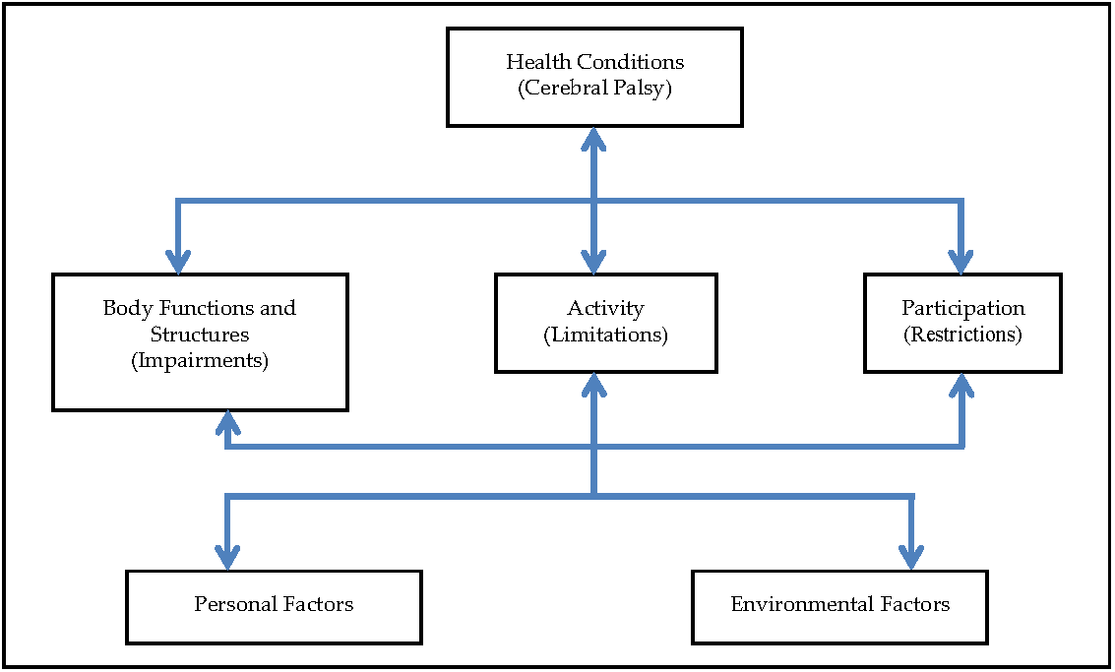
Case 1
Cerebral palsy
GMFCS IV, MACS IV
Spasticity, dystonia, contractures, pain
Difficulty
in ADL’s
Restricted participation to social life
Buildings, roads, public transport, education system (B), immediate family and attitudes (F/B)
Female, 14 years old
(behavioral problems)
Notes:
L hemiplegic CP due to postnatal infection at age 1
Very protective mother like all Turkish mothers
Does not eat in public

Slide 2
Baseline Evaluations for R UE
Subjective symptoms
Pain at night and during daily activities in R UE especially at shoulder and elbow joints
Difficulty in ADL’s due to pain and flexed elbow positioning (Problems with dressing, and hygiene)
No tolerance to orthotics
Poor tolerance to OT
Decreased participation to social life with her relatives/neighbors/friends (Always at home within the last month)
Dynamic positioning
Flexed elbow, pronated forearm, flexed wrist, TIP
Passive ROM
Reduced elbow extension (150°) and wrist extension (240°)
Active ROM
Active extension of the elbow is limited to 70°, no voluntary wrist extension, voluntary finger extension when wrist in full palmar flexed, no active supination
Spasticity Measurements
MAS 3 in elbow flexors, MAS 3 in wrist flexors, MAS 1+ in finger flexors
Tardieu XV3=50°, Y=2 in elbow flexors, XV3=110°, Y=3 in wrist flexors
Function
Poor passive assist

Slide 3
Treatment Goals
Decrease pain (Baseline VAS 8/10 for overall pain)
Improve reaching to involve R UE more in ADL’s (Baseline can not reach sink with R UE to wash her hands: active elbow extension 70°)
Improve tolerance to orthotics (Baseline can not wear)

Slide 4
Interventions
Multilevel BoNT-A injection to pectoralis major, brachialis, brachioradialis, flexor carpi ulnaris, flexor carpi radialis, pronator teres, pronator quadratus, flexor digitorum superficialis, flexor digitorum profundus, flexor pollicis longus and brevis muscles under ultrasound and e-stim guidance
3 weeks of OT

Slide 5
Evaluation for PGA at week 4
Cerebral palsy
GMFCS IV, MACS IV
Improvement in spasticity, pain, reaching, grasp, passive ROM
Improvement in
self care and ADL’s
Improved participation to social life
Buildings, roads, public transport, education system (B), immediate family and attitudes (F/B)
Female, 14 years old
(improvement in behavioral problems)
Notes:
L hemiplegic CP due to postnatal infection at age 1
Very protective mother like all Turkish mothers
Does not eat in public

Slide 6
Evaluation for PGA at week 4
History from parents/caregivers
Improvement in pain (No pain at night and decreased pain during daily activities)
Caregiving easier for dressing and hygiene
Attending her OT sessions
In a better mood, behaves better at home and improved participation to social life with her relatives/neighbors/friends (attending 2-3 social events/week)
Physical examination
Passive ROM improvement (175° elbow extension, 260° wrist extension)
Active ROM improvement up to 140° for elbow extension
Spasticity Measurements
MAS +1 in elbow flexors, MAS +1 in wrist flexors, MAS 1 in finger flexors
Tardieu XV3=110°, Y=2 in elbow flexors, XV3=190°, Y=2 in wrist flexors
Function
Improvement in reaching
Improvement in grasp
Treatment goals
Decreased pain (VAS 3/10 for overall pain)
Improvement in reaching to involve R UE more in ADL’s (GAS 0)
Improve tolerance to orthoses (GAS +1)

Slide 7
PGA
Rate the overall response to treatment with respect to pretreatment status of the patient
(+4) Markedly improved
(+3) Much improved
(+2) Improved
(+1) Slightly improved
(0) No change
(-1) Slightly worse
(-2) Worse
(-3) Much worse
(-4) Markedly worse

Slide 8
Case 2
Cerebral palsy
GMFCS IV, MACS I
Spasticity and lower extremity contractures
Exploring his environment
by crawling
Restricted participation to play activities
Parents very protective
Male,
4 years old
Notes:
L hemiplegic CP due to postnatal infection at age 1
Very protective mother like all Turkish mothers
Does not eat in public

Slide 9
Baseline Evaluations
Subjective symptoms
Can only wear very soft shoes for limited periods
No tolerance to orthotics
No tolerance to stretching exercises
Passive ROM
Ankle dorsiflexion 70° when knee flexed, 60° when extended
Active ROM
No active dorsiflexion
Spasticity Measurements
MAS 2 in hamstring, MAS 3 in plantar flexors
Tardieu XV3=60°, Y=2 in hamstring, XV3=30°, Y=3 in plantar flexor muscles
OGS
Total score R=4, L=4

Slide 10
Treatment Goals
Independent walking (Baseline: No steps with a walker independently, needs assistance)
Improve walking pattern (Baseline toe-toe gait)
Improve tolerance to orthotic wear (Baseline: No tolerance)

Slide 11
Interventions
BoNT-A injection to iliopsoas, rectus femoris, semitendinosus, semimembranosus, gracilis, and gastrocnemius muscles
Intermittent serial casting of both LE: 4 progressive casting (a short leg cast combined with an above knee cast) for 72 hours during 4 consecutive weekends started 10 days after BoNT-A treatment
Intensive functional rehabilitation for half day during week days for 4 weeks
Bilateral AFO

Slide 12
Evaluation for PGA at week 12
Cerebral palsy
GMFCS II, MACS I
Improvement in spasticity, passive ROM, and
gait pattern
Independent walker
Improved participation to play activities
Mother still very protective,
Father very interested in teaching him football
Male
4 years old
Notes:
L hemiplegic CP due to postnatal infection at age 1
Very protective mother like all Turkish mothers
Does not eat in public

Slide 13
Evaluation for PGA at week 12
History from parents/caregivers
Started wearing shoes and had independent 3-5 steps at week 5, independent walking indoors at week 9
Very happy with the posture and walking pattern
Reported frequent falls (5-6 falls/day)
Passive ROM
Ankle dorsiflexion 105 degrees when knee flexed, 95 when extended
Active ROM
Can not activate dorsiflexor muscles
Spasticity Measurements
MAS 1 in hamstring, MAS 1 in plantar flexors
Tardieu XV3=115°, Y=2 in hamstring, XV3=90°, Y=2 in plantar flexor muscles
OGS
Total score R=14, L=13
Improved tolerance to orthotics (4-5 hours)
Improved tolerance to stretching exercises

Slide 14
Evaluation for PGA at week 12
Treatment Goals
Independent walking (GAS +2)
Improve walking pattern (GAS +1)
Improve tolerance to orthotic wear (GAS +2)

Slide 15
PGA
Rate the overall response to treatment with respect to pretreatment status of the patient
(+4) Markedly improved
(+3) Much improved
(+2) Improved
(+1) Slightly improved
(0) No change
(-1) Slightly worse
(-2) Worse
(-3) Much worse
(-4) Markedly worse

Slide 16
Case 3
Cerebral palsy
GMFCS IV, MACS III
Spasticity
in left UE
Difficulty
in ADL’s
Restricted participation to play activities
Large family living together (F)
Many caregivers within the family (F)
Male, 6 years old
Notes:
L hemiplegic CP due to postnatal infection at age 1
Very protective mother like all Turkish mothers
Does not eat in public

Slide 17
Baseline Evaluations for L UE
Dynamic positioning
Flexed elbow, pronated forearm, flexed wrist, TIP
Passive ROM
Full elbow extension, 255° of wrist extension
Active ROM
Active elbow extension to 110°, no voluntary wrist extension, voluntary finger extension only in full palmar flexed position of the wrist joint
Spasticity Measurements
MAS 2 in elbow flexors, MAS 3 in wrist flexors, MAS 1+ in finger flexors
Tardieu XV3=90°, Y=2 in elbow flexors, XV3=140°, Y=3 in wrist flexors
Function
No spontaneous use, poor passive assist, can hold very limited subjects when positioned in his hand
Poor tolerance to orthotics (15-30 minutes)
Poor tolerance to stretching exercises

Slide 18
Treatment Goals
Improve dynamic positioning and posture of the L UE (Baseline posture flexed elbow at 90-100° and flexed wrist at 90-110°)
Improve grasp and release to involve L UE more in ADL’s as an assisting hand (Baseline no spontaneous use, poor passive assist)
Improve reaching (Baseline active elbow extension to 110°)

Slide 19
Interventions
Multilevel BoNT-A injection to brachialis, brachioradialis, flexor carpi radialis, flexor carpi ulnaris, pronator teres, pronator quadratus, flexor digitorum superficialis and flexor pollicis brevis/adductor pollicis/opponens pollicis muscles under deep sedation with e-stim guidance
3 weeks of OT

Slide 20
Evaluation for PGA at week 4
Cerebral palsy
GMFCS IV, MACS III
Improvement in spasticity, PROM, and active extension of the wrist. Weakened flexor muscles!
Dressing of upper extremity is easier
Restricted participation to play activities
Large family living together very supportive (F)
Many caregivers within the family (F)
Male, 6 years old
Notes:
L hemiplegic CP due to postnatal infection at age 1
Very protective mother like all Turkish mothers
Does not eat in public

Slide 21
Evaluation for PGA at week 4
History from parents/caregivers
Happy with the posture, have concerns about weakness
Physical examination
Passive ROM full wrist extension
Active ROM full elbow extension, active wrist extension to 200°
MAS 0 in elbow flexors, MAS 1 in wrist flexors, MAS 0 in finger flexors
Tardieu XV3=165°, Y=2 in elbow flexors, XV3=255° Y=2 in wrist flexors
Function
Improvement in reaching
Improvement in active extension of the wrist
Worsening in grasp related tasks, can not hold any object even positioned in his hand
Treatment objectives
Improvement in dynamic positioning and posture (GAS +1)
Better reaching (GAS +1)
Worsened grasping, no spontaneous use, no passive assist (GAS -2)
Splint/orthoses in the study limb
Increased tolerance to resting splints (4-6 hours)
OT
Increased tolerance to stretching exercises

Slide 22
PGA
Rate the overall response to treatment with respect to pretreatment status of the patient
(+4) Markedly improved
(+3) Much improved
(+2) Improved
(+1) Slightly improved
(0) No change
(-1) Slightly worse
(-2) Worse
(-3) Much worse
(-4) Markedly worse

